Slide 1
CSS342 Data Structures, Algorithms, and Discrete Mathematics (I)

Slide 2
Goals by the end of this week (10/8, 10/10)
Join Discord (last call)
Get comfortable with write C++, Makefile
Get familiar with CMake
OOP design
Better Code/Testing Quality
Textbook “Data Abstraction & Problem Solving With C++”

Slide 3
C++
No more C++ review from next week
Still okay to ask questions
We will only review C++ quickly
If in high doubt
CSS332 Programming with object oriented languages
A longer “boot camp” on C++
Although this is not a prerequisite for CSS342, do take this class if at all possible if you are not familiar with C++
Quantitative Skills Center (tutoring) – Visit http://www.uwb.edu/gsc for more information
A good video tutorial series

Slide 4
Homework Review
link to home 2
do bonus task first
DUE: 10/14/2019 Monday 11:59pm
No Late homework
Make sure your canvas submission succeeds

Slide 5
Homework Review
We will review homework 1 on Thursday
A few problems I’ve seen in submission:
Read the problem description carefully. Ask for clarification if needed
Reuse code
SWAP function in reverse() and sort()
Test more thoroughly
testAdd() “if array size matches the amount added, it’s correct”
testSort() “if output is ascending, it’s correct”
testReverse() “reverse twice and if it equals the original, it’s correct”
Only submit files asked. No executables!
Test should say PASS or FAIL

Slide 6
Homework Review
We will review homework 1 on Thursday
A few problems I’ve seen in submission:
Read the problem description carefully. Ask for clarification if needed
Reuse code
SWAP function in reverse() and sort()
Test more thoroughly
testAdd() “if array size matches the amount added, it’s correct”
testSort() “if output is ascending, it’s correct”
testReverse() “reverse twice and if it equals the original, it’s correct”
Only submit files asked. No executables!
Test should say PASS or FAIL

Slide 7
Homework Review
We will review homework 1 on Thursday
A few problems I’ve seen in submission:
Read the problem description carefully. Ask for clarification if needed
Reuse code
SWAP function in reverse() and sort()
Test more thoroughly
testAdd() “if array size matches the amount added, it’s correct”
testSort() “if output is ascending, it’s correct”
testReverse() “reverse twice and if it equals the original, it’s correct”
Only submit files asked. No executables!
Test should say PASS or FAIL

Slide 8
Linux
A great intro tutorial video
A hands-on session to go through the basic Linux ops
Time and place TBD

Slide 9
C++ Review
Polymorphism, Virtual function (virtual_function_example)

Slide 10
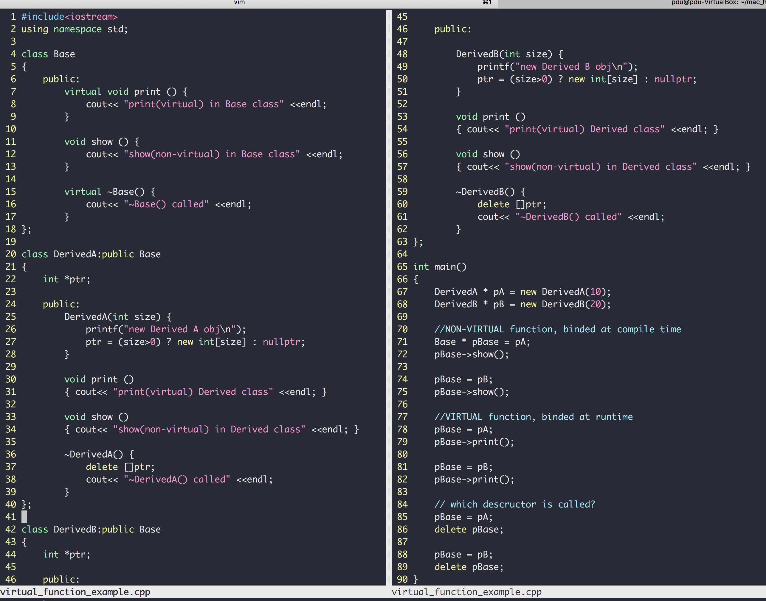
C++
“DerivedA class is a kind of Base class"
Class inheritance
Polymorphism
Virtual members
Pointers to base class
Invoke derived func
more example here
Same base pointer, different functions invoked (dynamic binding)

Slide 11
Base::foo() is NOT virtual
Derived Class
Derived obj;
Base * p = &obj;
Base::Foo()
Base Class
p -> foo()
Derived::Foo()

Slide 12
Base::foo() is virtual
Derived Class
Derived obj;
Base * p = &obj;
Base::Foo()
Base Class
p -> foo()
Derived::Foo()

Slide 13
C++ Exercise
A card class
Has only one member function called area() that returns the area of the card
Write the class for card, square card and circular card
area() is implemented in the way of polymorphism
Unit is float
rectangle Card
Area = width x height
Circular Card
Area = pi x radius²
card
Area = ??

Slide 14
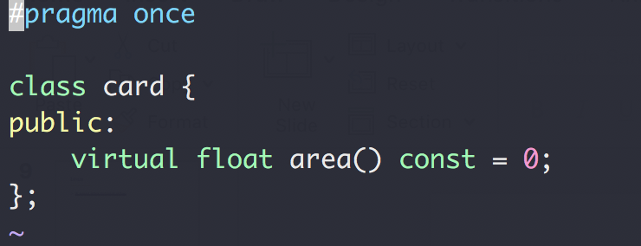
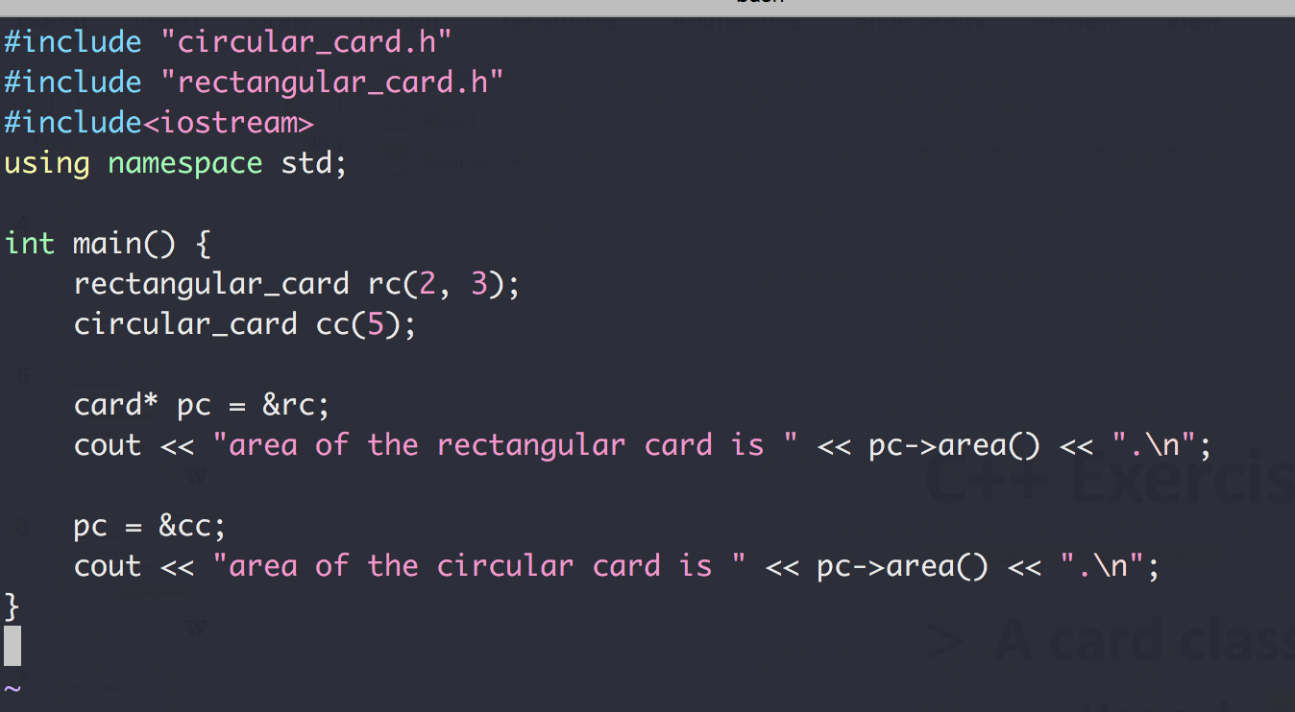
C++ Exercise

Slide 15
C++ Review
Template
A parameterized blueprint
Function Template (code: function_template)
Class Template (code: card_exercise/templated_version/)

Slide 16
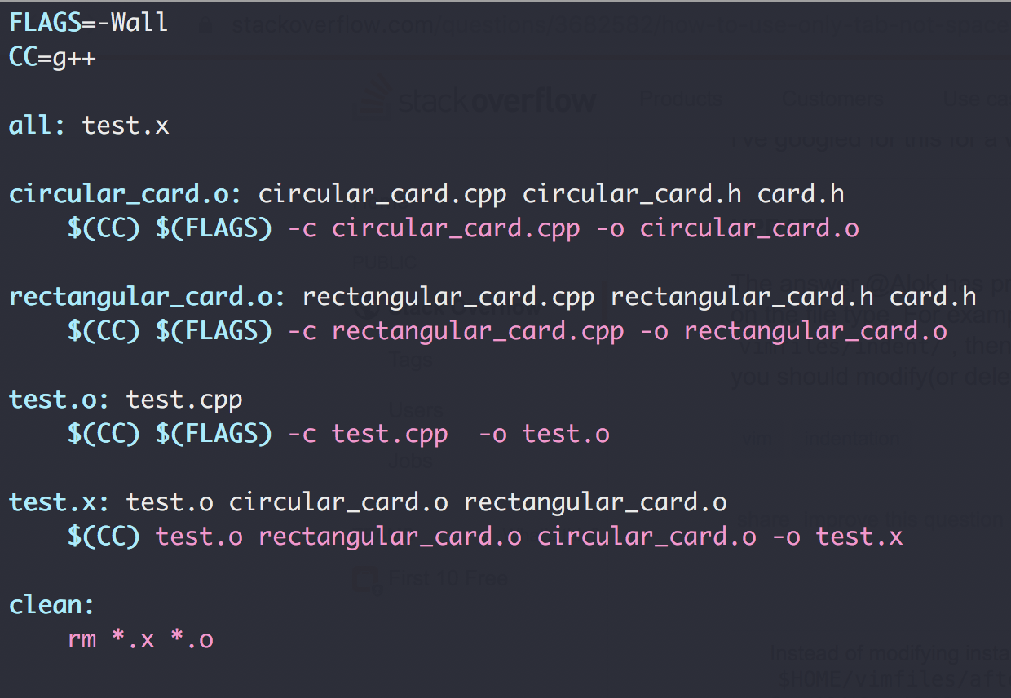
Makefile
goal
dependencies
actions

Slide 17
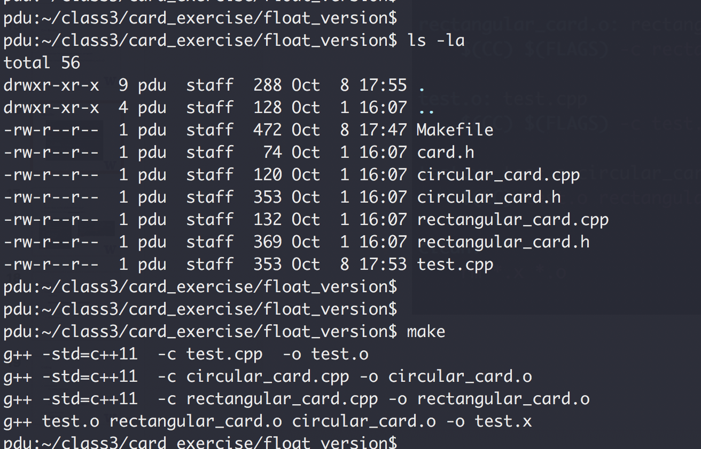
Makefile

Slide 18
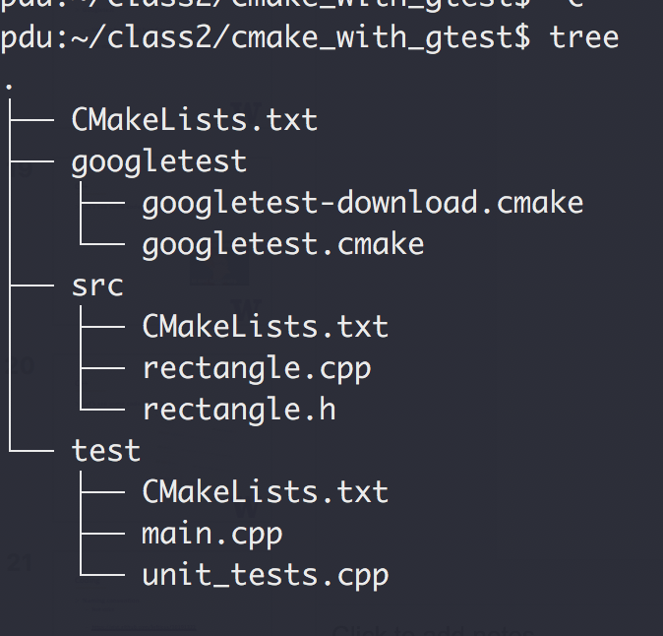
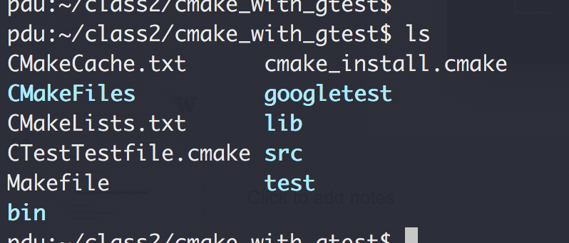
CMake
Tools that write Makefile for you!
Cross-platform (Yes, Windows too)
cmake .
make
A good CMake tutorial

Slide 19
Coding
Naming convention
Not strict
https://gist.github.com/lefticus/10191322
Bottomline:
Pick and follow a rule set
Be consistent

Slide 20
Coding
Avoid duplicates
No same logic more than once!
No same constants more than once
Comments
On intent, not action
Modular
Cohesion: 1 task per module
Coupling: As loosely coupled as possible
Variable Naming
Jacob’s guide

Slide 21
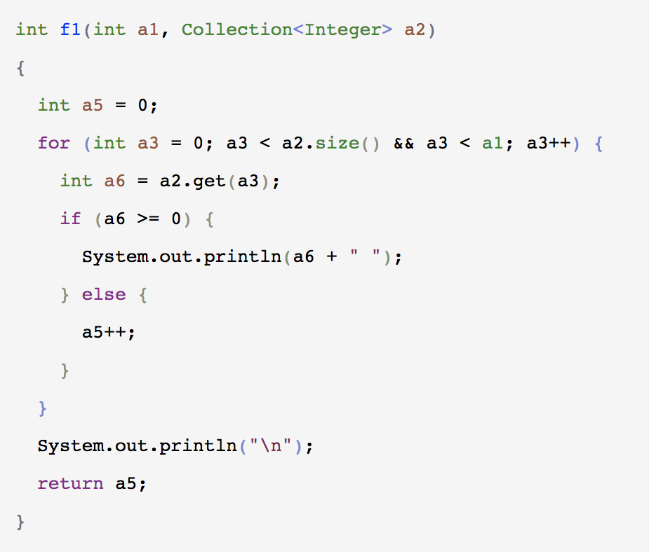
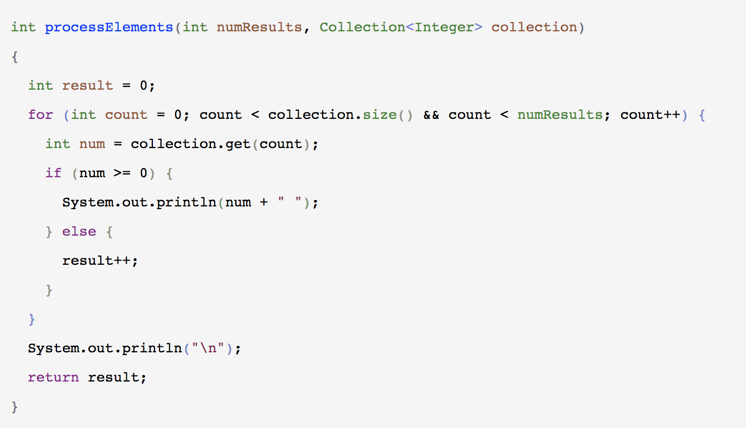
Coding
https://a-nickels-worth.blogspot.com/2016/04/a-guide-to-naming-variables.html

Slide 22
Coding
Testing
Unit tests:
individual units/ components of a software are tested
smallest testable unit
MyArray::Sort()
MyArray::Reverse()
MyArray::Swap
Integration tests
Test Driven Development
Video: “TDD, Where Did It All Go Wrong”

Slide 23
END OF C++ REVIEW

Slide 24
Notes on homework 2
Makefiles
File structures

Slide 25
Homework Review
We will review homework 1 on Thursday
Read the problem description carefully. Ask for clarification if needed
Reuse code
SWAP function in reverse() and sort()
Test more thoroughly
testAdd() “if array size matches the amount added, it’s correct”
testSort() “if output is ascending, it’s correct”
testReverse() “reverse twice and if it equals the original, it’s correct”
Only submit files asked. No executables!
Test should say PASS or FAIL
Do not use goto (not in this class)
Remove unused/commented-out code from submission
Bug in the subscription [] operator
- About that swap….can you do it in-place?
Notes:
About that swap….can you do it in-place?

Slide 26
Object-Oriented Analysis And Design
What does “problem solving” mean?
Give a list of elements, implement the following function:
Add an element to the back of the list push_back(…)
Remove an element from the front of the list pop_front(…)
3
9
1
7
5
4
2
0
pushBack(…)
popFront(…)
4
2
0

Slide 27
Object-Oriented Analysis And Design
What does “problem solving” mean?
Give a list of elements, implement the following function:
Add an element to the back of the list push_back(…)
Remove an element from the front of the list pop_front(…)
10 mins, design and write the code
Use array in C++ to storage the data

Slide 28
Object-Oriented Analysis And Design
Let’s see some code

Slide 29
Object-Oriented Analysis And Design
What does “problem solving” mean?
Given a list of elements, implement the following function:
Add an element to the back of the list push_back(…)
Remove an element from the front of the list pop_front(…)
Procedural (aka steps)
Class Entity
Abstract Data Type
array
Array
pushback()
popFront()
Member variables
PushBack()
Member functions
PopFront()
Test
Test()

Slide 30
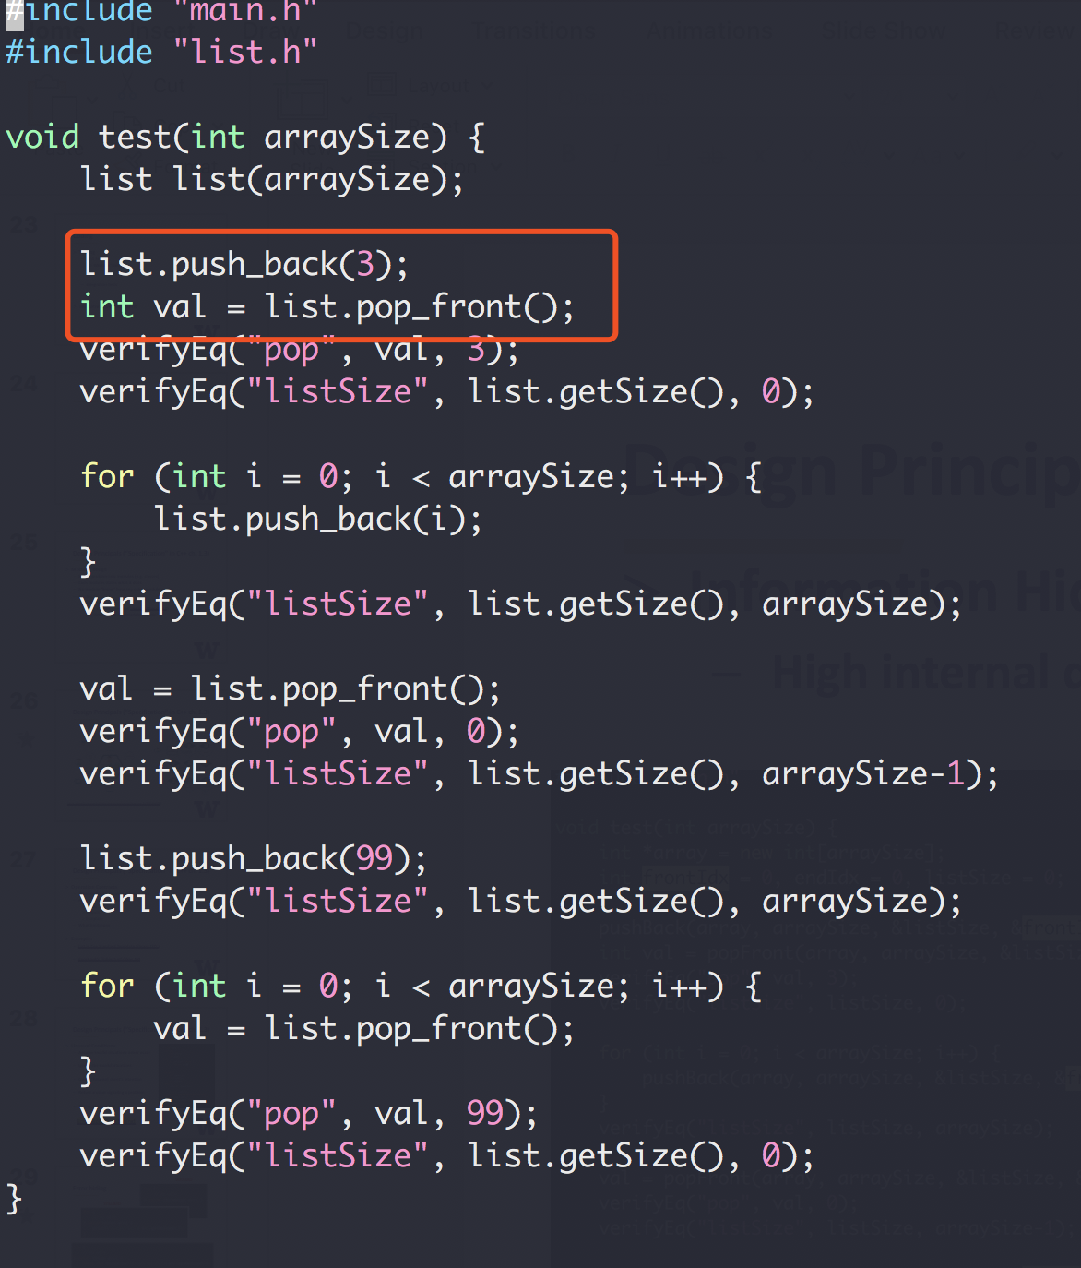
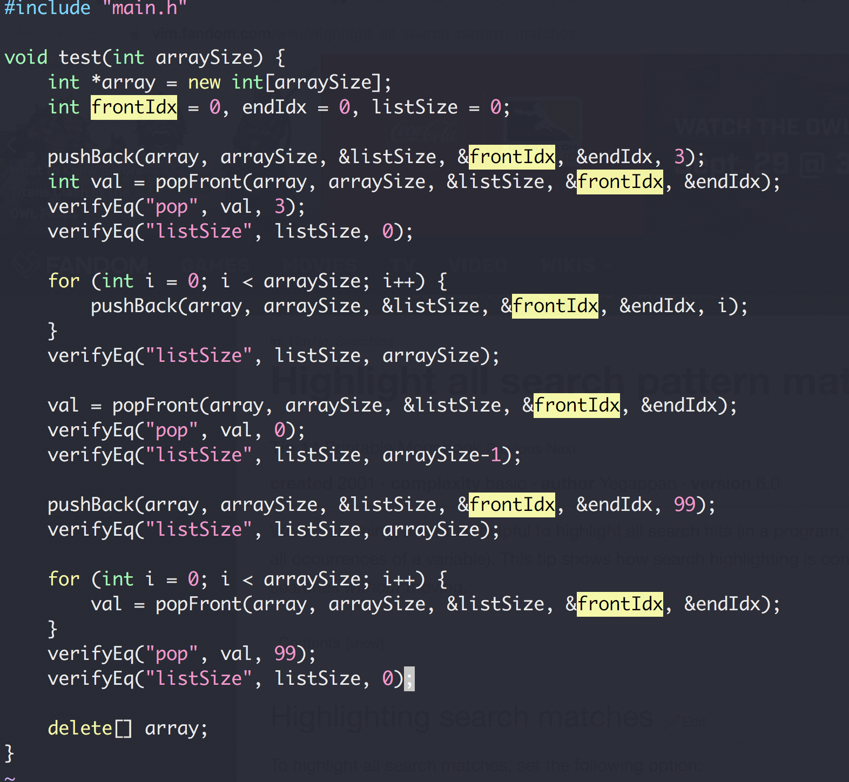
Object-Oriented Analysis And Design

Slide 31
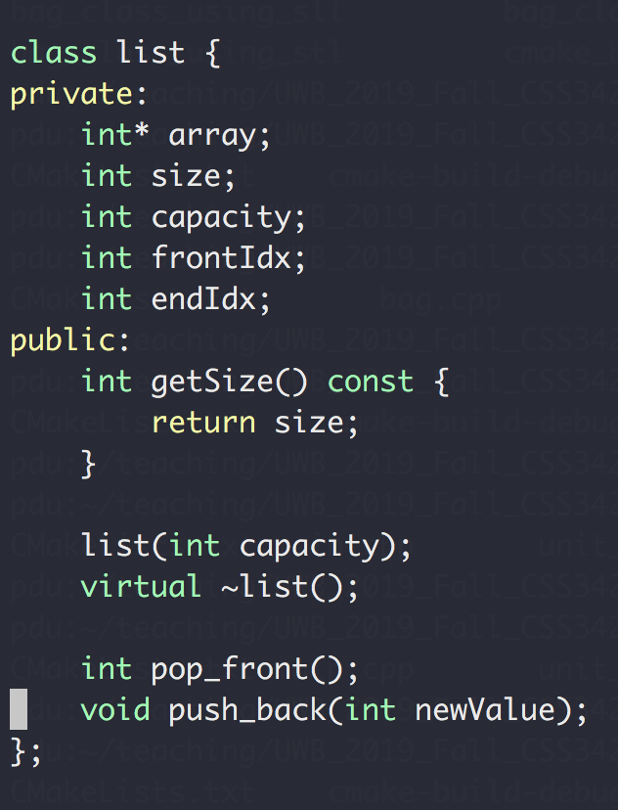
Object-Oriented Analysis And Design
Given a list of elements, implement the following function:
Add an element to the back of the list push_back(…)
Remove an element from the front of the list pop_front(…)
Abstract Data Type
1. defined by its behavior
2. from the point of view of a user of the data

Slide 32
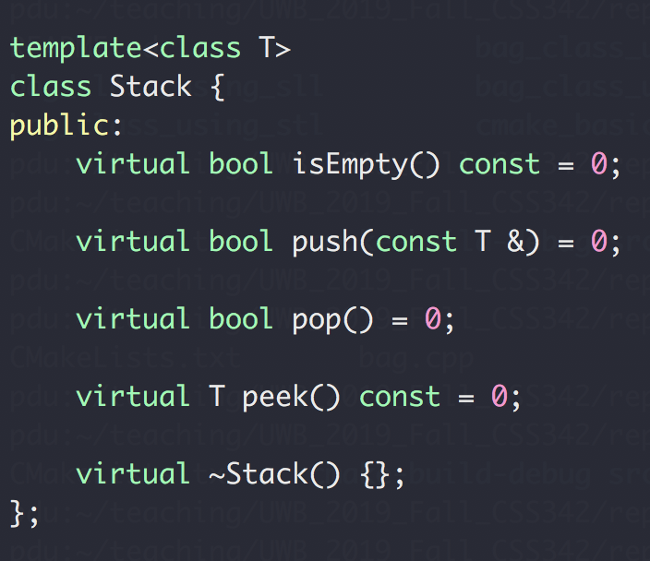
Exercise 1
Design a Stack ADT
First in, last out
Usage: reverse a list, and many others

Slide 33
Exercise 1
Design a Stack ADT
First in, first out

Slide 34
Exercise 2
Design a Single Linked List
A collection of nodes
Can only be accesses in a sequential way
No random access
Node
NEXT
NEXT
NEXT
NEXT
end

Slide 35
Exercise 2
Design a Single Linked List
A collection of nodes
Can only be accesses in a sequential way
No random access
prepend(value) : Add a node in the beginning append(value) : Add a node in the end
pop() : Remove a node from the end popFirst() : Remove a node from the beginning
head() : Return the first node tail() : Return the last node
remove(Node) : Remove Node from the list
iterator: iterate through the list
https://medium.com/@lucasmagnum/sidenotes-linked-list-abstract-data-type-and-data-structure-fd2f8276ab53

Slide 36
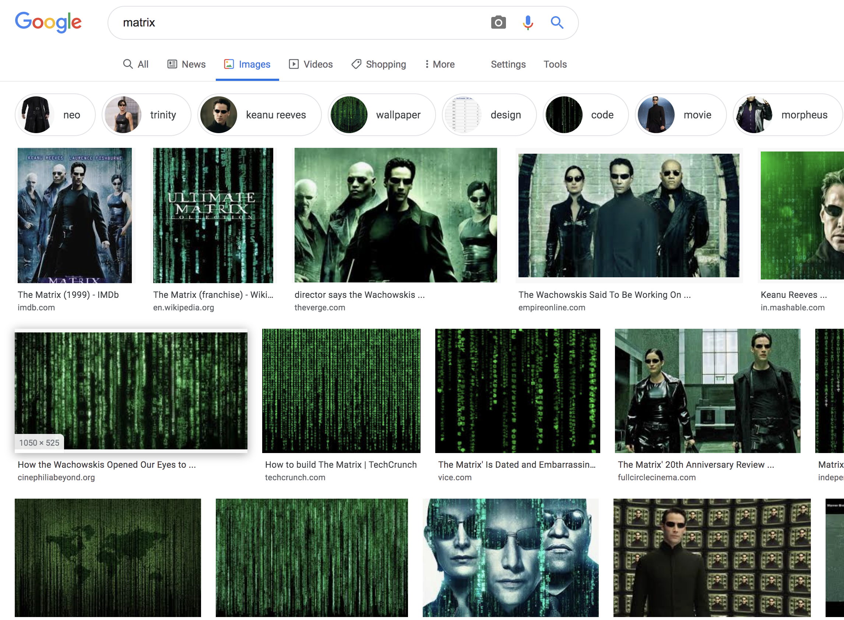
Exercise 3
Design a Matrix

Slide 37
Exercise 3
Design a Matrix
An example of a matrix interface design

Slide 38
Design Principals (“Specification” in C++ ch. 1.3)
Modular design
Split a problem into modules (e.g. classes)
Each modules states what it does
No module “know” how any other module works
Applies to
Single application (e.g. main, list, test)
Large scale Microservices (see how Uber does it)
And remember the class scheduling example?

Slide 39
Design Principals (“Specification” in C++ ch. 1.3)
https://medium.com/edureka/microservice-architecture-5e7f056b90f1

Slide 40
Design Principals (“Specification” in C++ ch. 1.3)
Operation Contracts
What methods are available to public
How a method can be used
Inputs
Outputs
Exception
What limitations
Example:
List in C++ Standard Template Library (STL)
Facebook’s /{object-id}/likes API

Slide 41
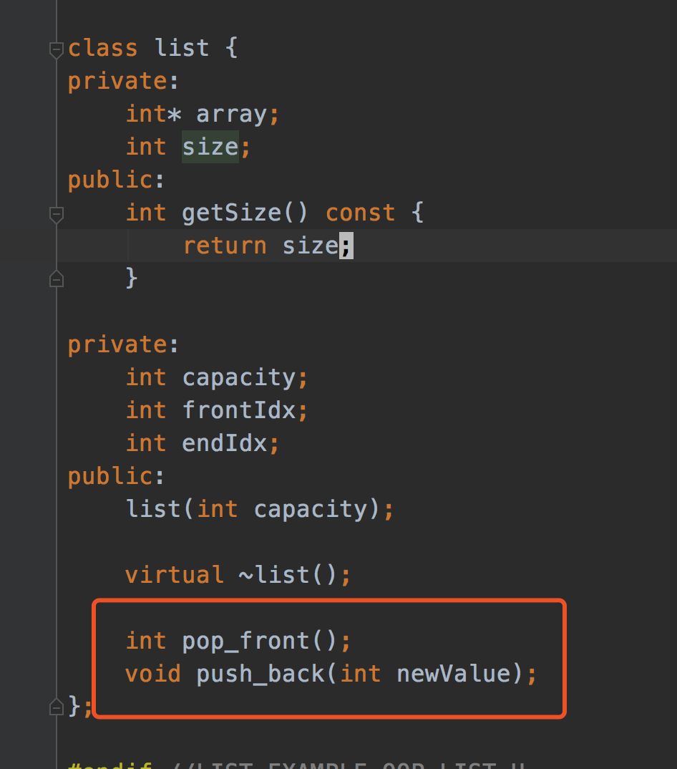
Design Principals (“Specification” in C++ ch. 1.3)
Unusual Conditions
Assume invalid situations never occur
Ignore the invalid situations
Guess (Assume) client’s intention
Return a value signaling a problem
Throw an exception
Error Hiding (swallowing)

Slide 42
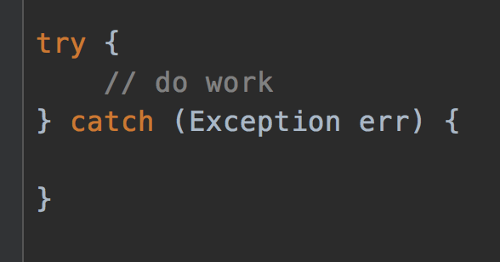
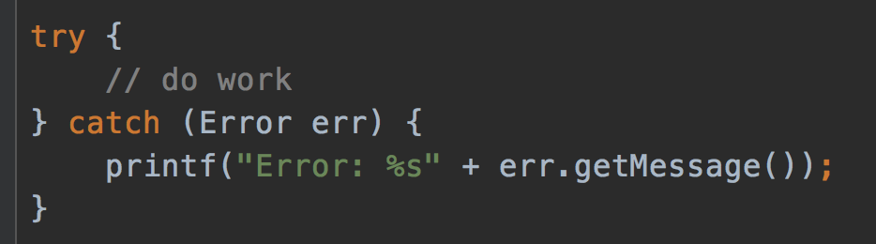
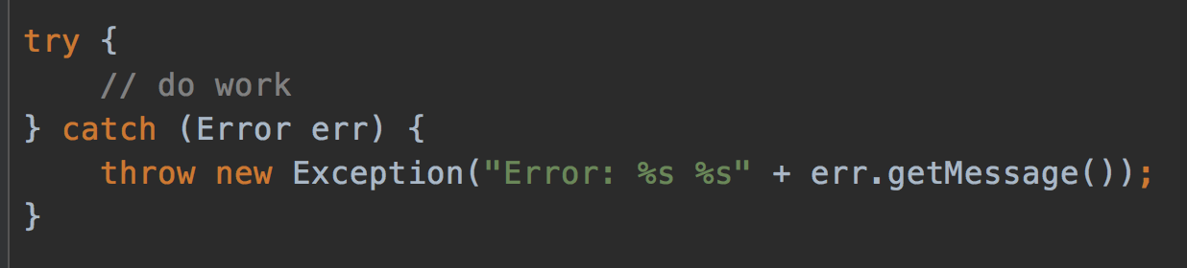
Error hiding
VERY BAD
STILL BAD
GOOD, but how to improve?
https://www.ibm.com/support/pages/best-practice-catching-and-re-throwing-java-exceptions

Slide 43
Design Principals (“Specification” in C++ ch. 1.3)
Information Hiding
High internal details from external clients

Slide 44
OOP Design
A bag of card of different shape cards
Exercise

